Slide 1
Escape Room
Individueel project
Floor Wieringa
8-9-2022

Slide 2
Plans Initially & later on
Text-based --> picture-based
Local --> Heroku deployment
One inventory system for usage + display -->
Separate systems for usage / display

Slide 3
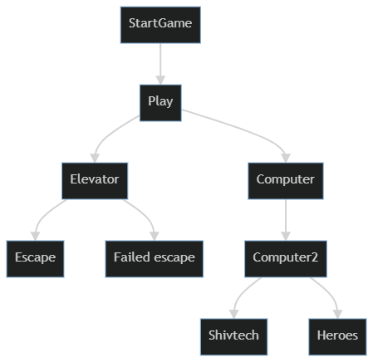
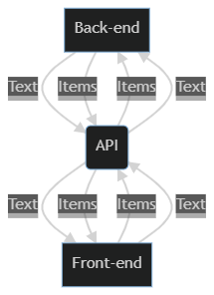
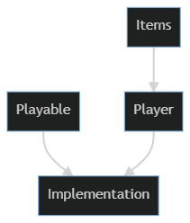
Architecture (React)

Slide 4
Goals Technical & personal
Mental overview of model
Connections between files on the same end
Connections between front- and back-end
Priorities

Slide 5
To-do’s
Mobile view
Aesthetics
Inventory system more visually intuitive

Slide 6
The product
http://escape-room-the-lair.herokuapp.com/

